Slide 1
GCBASIC
PIC18FxxQ35chip Family
Part 13 - Using a SPI GLCD display solutions

Slide 2

GCBASIC
PIC18FxxQ35chip Family
Part 13 - Using a SPI GLCD display solutions

Slide 3
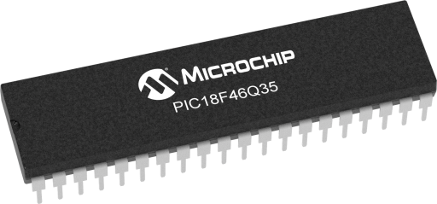
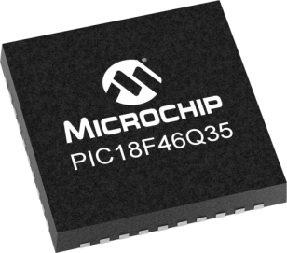
GCBASIC
Like and subscribe!

Slide 4
PIC18FxxQ35
PIC18FxxQ35 is a high performance PIC18
Digital and analog peripherals for flexible embedded control
10-bit ADC for accurate analog signal conversion
Multiple communication interfaces including UART (serial), I²C, and SPI
PWM modules with CCP and 16-bit resolution for precise timing and motor control
Configurable Logic Cells (CLCs) for custom hardware-level logic without external components
Integrated op amps for onboard analog signal conditioning and amplification
The PIC18FxxQ35 offers 28, 40 and 44-pin products in small footprint packages to support customers in a wide variety of applications.

Slide 5
Videos...
Install the hardware and make the board work – make LEDs work
Make four LEDs flash in a sequence
Set the LEDs to represent the value of ADC
Sequence the LEDs with a delay using the value of ADC
Using an input to set the state of the LEDs
Using the reset switch
Using the switch, ADC – make the LEDs flash in a sequence with reverse
Using the serial to display values
Using the timer0 overflow, 8bit timer, 16bit timer to flash the LEDs
Using EEProm – showing values on the serial terminal, and more constants insights
Using I2C with serial to discover I2C devices
Using an I2C GCLD display
Using a SPI GCLD display
Using PWM, many ways, to dim the LEDS
Using an external interrupt to control an LED
Using storage within the chip – Progmem, SAF memory, EEPROM and DATA blocks
Using CLC
The GCBASIC tool chain
Assembly , alternatives assemblers and MPLAB-X
Summary

Slide 6
GCBASIC Compiler
GCBASIC Compiler
GCBASIC is an Open Source compiler for PIC, AVR and LGT microcontrollers
GCBASIC now supports the 18FxxQ35 chip family
GCBASIC now supports 1400+ microcontrollers

Slide 7
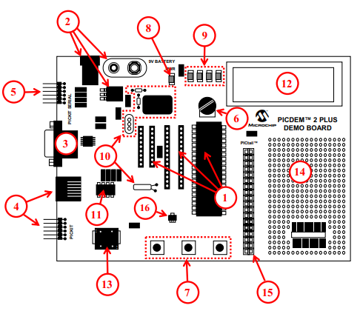
PICDEM 2 Plus Demonstration
Board
1. 18-, 28- and 40-pin DIP sockets
(although three sockets are provided, only one device may be used at a time)
2. On-board, +5V regulator for direct input from 9V, 100 mA AC/DC wall adapter or 9V battery, or hooks for a +5V, 100 mA regulated DC supply
3. RS-232 socket and associated hardware for direct connection to an RS-232 interface
4. Programmer/debugger connectivity supporting MPLAB® ICD 3, MPLAB REAL ICE and PICkitPlus
5. PICkit Serial Connector for analysis of serial communications peripherals such as SPI or I2C™
6. 5 k pot for devices with analog inputs
7. Three push button switches for external stimulus and Reset
8. Power-on indicator LED
9. Four LEDs connected to PORTB
10. On-board external oscillators including:
a) Unpopulated DIP socket for canned crystal oscillator (Y2)
b) RC oscillator circuit (R4, C3)
c) Unpopulated holes for crystal connection (Y1)
d) 32.768 kHz crystal for Timer1 clock operation (Y3) 11. 32K x 8 Serial EEPROM
12. LCD display
13. Piezo buzzer
14. Prototype area for user hardware
15. Expansion Header for PICtail™ daughter card connectivity or user access to MCU pins
16. Microchip TC74 thermal sensor
Plus SPI GLCD
3A

Slide 8
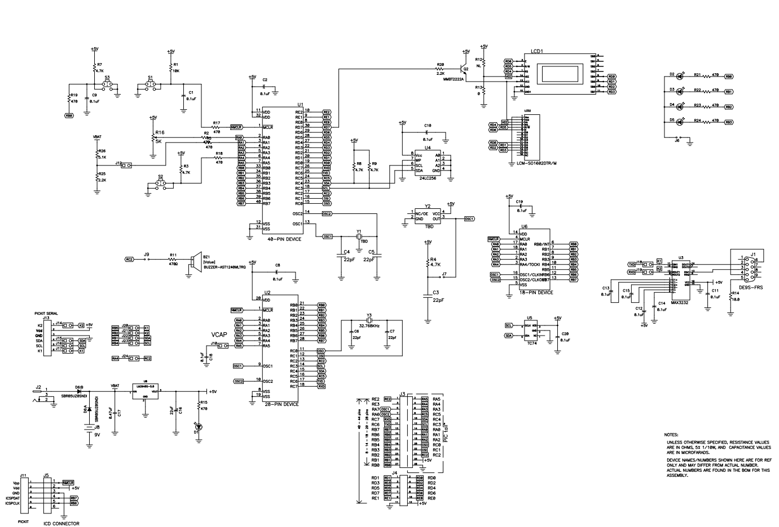
PICDEM 2 Plus Demonstration
Board

Slide 9
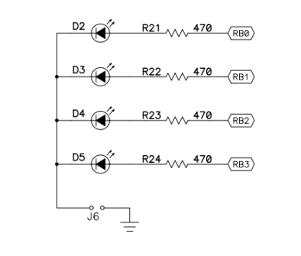
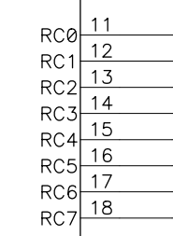
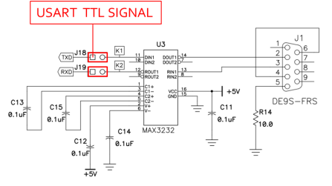
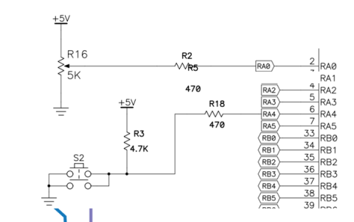
Schematic
DC
CS
RST
SCK
SDO
TX1
18
VDDIO2

Slide 10
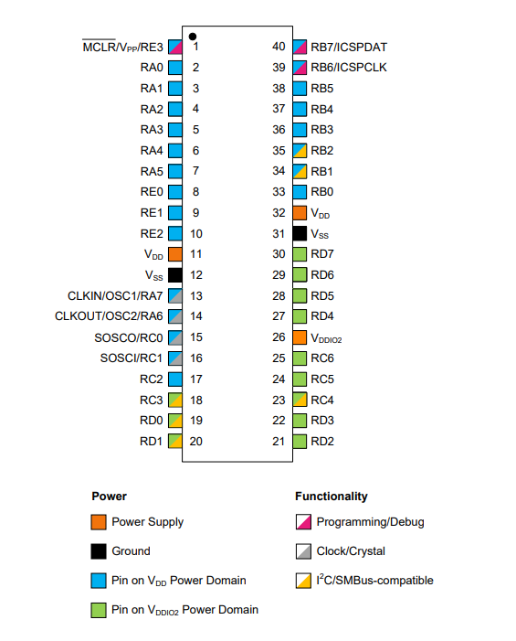
VDDIO2 Domain Power
Think No VDDIO2 power – no domain I/O!

Slide 11
Prerequisites
Assumes you have
Installed the GCBASIC software
Installed your programmer software
Test that you have the 18FxxQ35 attached
You have the 4 LEDs operating
You have a POT connected
You have SWITCHes connected
You have a USB/TTL converter
GLCD SPI device

Slide 12
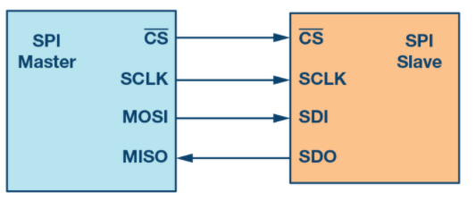
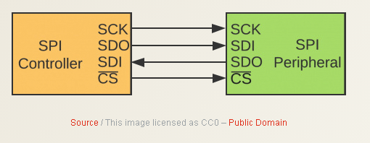
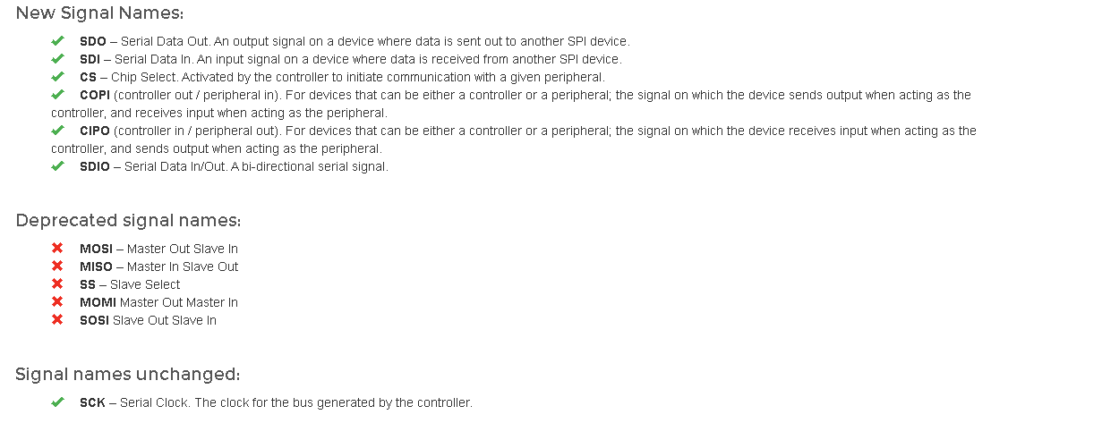
SPI
Serial Peripheral Interface (SPI) is an interface bus commonly used to send data between microcontrollers and small peripherals such as GLCD, shift registers, sensors, and SD cards.
It uses separate clock and data lines, along with a select line to choose the device you wish to control.

Slide 13
Hardware
Prototype Board
Power 5v0
Programmer
LEDs & resistors
Switches & resistors
SPI device and circuit
------------------PORTC-----------------
Bit#: -7---6---5---4---3---2---1---0---
IO: VDD-TX------SDO-SCK-RST--CS--DC--
----------------------------------------

Slide 14
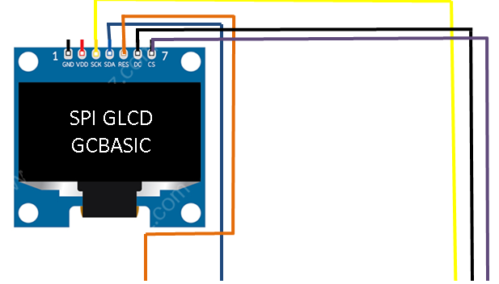
Setup - Connections

Slide 15
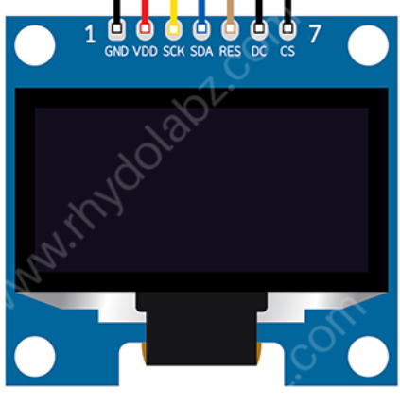
Setup - Program
SPI GLCD
GCBASIC
DATA
This is a PPS chip, so, needs to make the PPS match these assignments
/* Pin mappings for GLCD data and clock
#DEFINE GLCD_DO portC.4
#DEFINE GLCD_SCK portC.3
/* Pin mappings for GLCD support
#DEFINE GLCD_DC portC.0
#DEFINE GLCD_CS portC.1
#DEFINE GLCD_RESET portC.2 #DEFINE SSD1331_HardwareSPI

Slide 16
Setup – when things do not work ..
Things do not always work
The more connections the more trouble
Things we know
The GLCD demonstration works
Therefore is not likely to be the libraries but … work through the checklist first
Checklist
Check your connections, twice
Write a program to pulse a signal on each line, each line on at a time
Always use the software SPI first to prove connectivity
Then, use PPS/hardware SPI is #3 works

Slide 17
Lab
Review setup and operation of a SPI GLCD
Software SPI – bit banging
Harware SPI – with PPS ( of course)
Conditional compilation

Slide 19
Videos...
Install the hardware and make the board work – three LED programs
Make four LEDs flash in a sequence
Set the LEDs to represent the value of ADC
Sequence the LEDs with a delay using the value of ADC
Using an input to set the state of the LEDs
Using the reset switch
Using the switch, ADC – make the LEDs flash in a sequence with reverse
Using the serial to display values
Using the timer0 overflow, 8bit timer, 16bit timer to flash the LEDs
Using EEProm – showing values on the serial terminal, and more constants insights
Using I2C with serial to discover I2C devices
Using I2C GCLD display solutions
Using a SPI GLCD display solutions
Using PWM, many ways, to dim the LEDS
Using an external interrupt to control an LED
Using storage within the chip – Progmem, SAF memory, EEPROM and DATA blocks
Using CLC
The GCBASIC tool chain
Assembly , alternatives assemblers and MPLAB-X
Summary

Slide 20
GCBASIC
PIC18FxxQ35chip Family
Part 13 - Using a SPI GLCD display solutions

